Slide 1
Supply Chain Data Integration System

Slide 2
AGENDA
Project Overview
Problem Statement
Project Architecture
Star Schema Design (Big Query)
ETL Pipeline (Python)
Key Metrics Calculated
Streamlit Dashboard
Conclusion

Slide 3
Project Overview
To build a data integration system that combines historical order data with live inventory from an external API, enabling real-time supply chain insights through a dashboard.

Slide 4
Problem Statement
Modern supply chains face:
Fragmented data across systems
Lack of real-time visibility
Manual effort to track inventory and returns
This project bridges operational data (CSV) and external inventory (API) into one analytical platform.

Slide 5
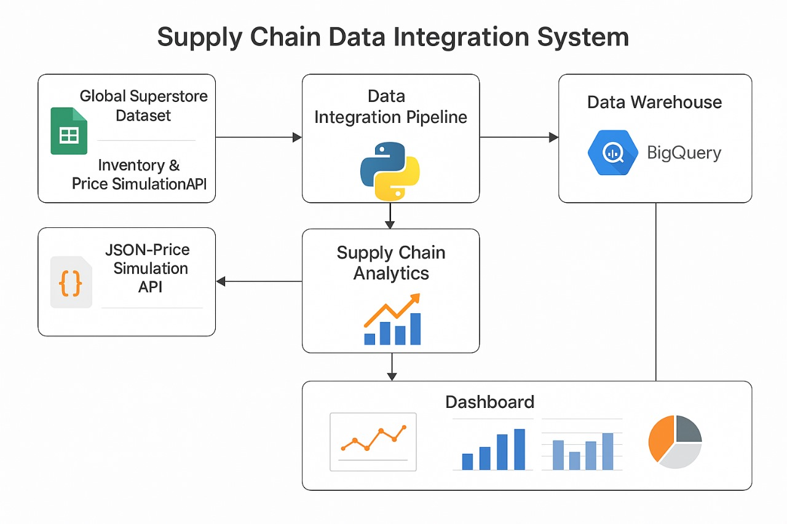
Project Architecture

Slide 6
Star Schema
Fact Table:
fact_orders: order date, ship date, sales, profit, return flag
fact_inventory: inventory level, restock, stockouts
Dimension Tables:
dim_product: product ID, name, category, price
dim_customer: customer info
dim_time: order/ship dates
dim_location: region, market, shipping mode

Slide 7
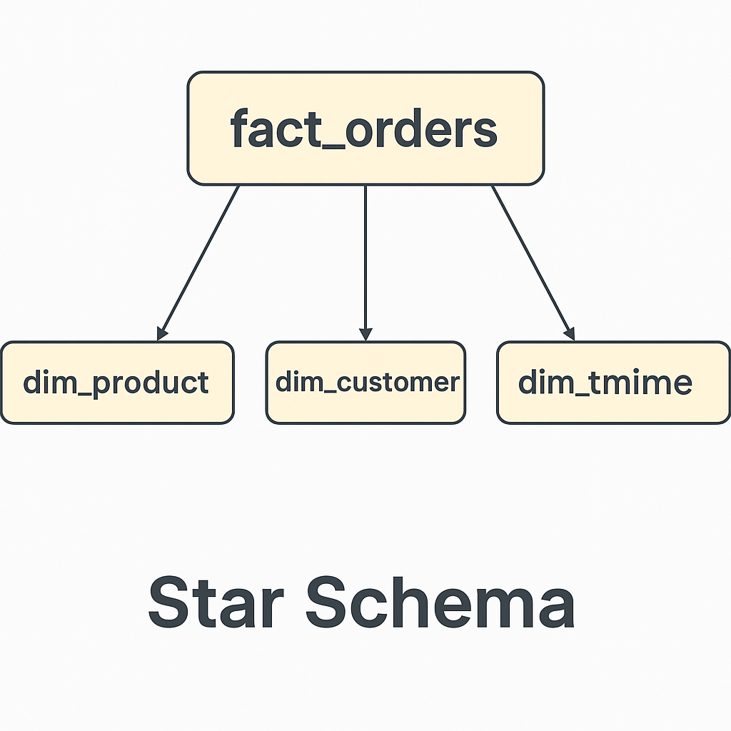
Design

Slide 8
ETL Pipeline (Python)
Extract
From CSV (pandas) and API (requests)
Transform
Clean data, generate metrics, normalize columns
Load
BigQuery table upload via google.cloud.bigquery

Slide 9
Key Metrics Calculated
🕒 Lead Time
💸 Total Sales
📦 Fill Rate & Return Rate
⏱️ On-Time Delivery Rate
📊 Inventory Trends & Stockouts
🧾 Category & Segment Performance

Slide 10
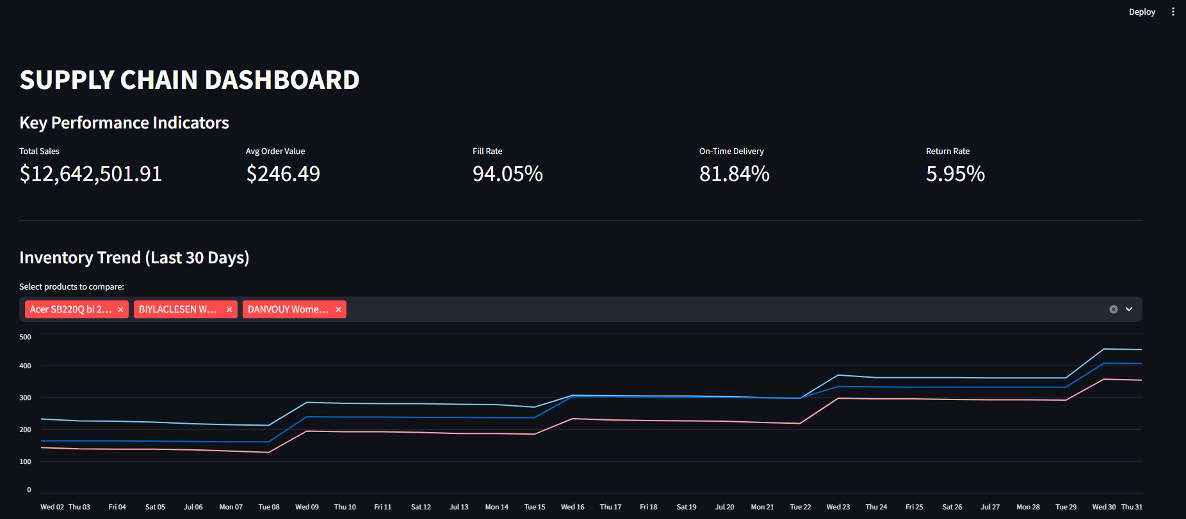
Streamlit Dashboard

Slide 11
Conclusion
Conclusion: This project demonstrates how historical and real-time data can be unified into a single view for faster business decisions.

